Slide 1
Sales Call Centre Performance
FOCUS: Grade of Service

Slide 2
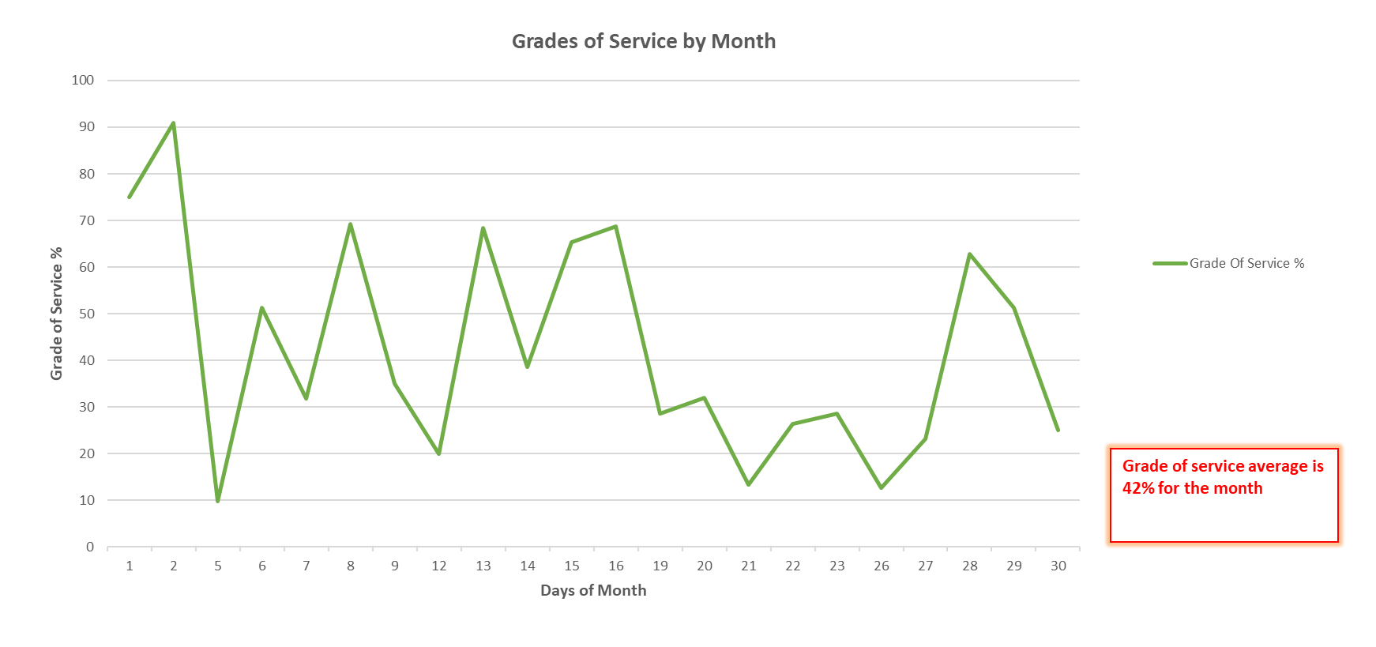
Chart 1

Slide 3
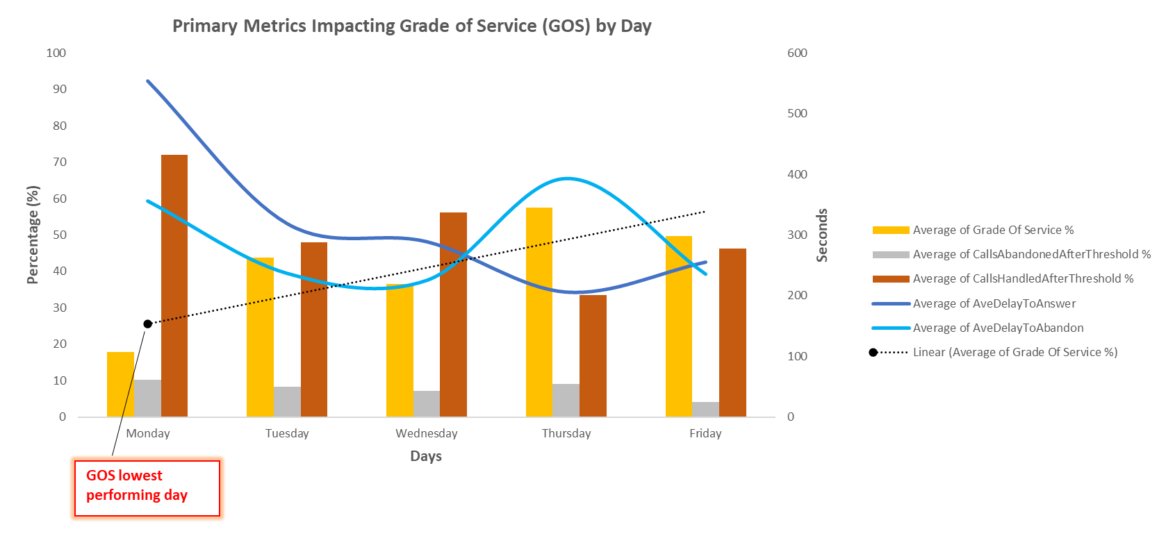
Chart 2

Slide 4
Overview
Insurance company call centre data from 2014 was provided for the sales department, who manage inbound calls for motor, home, landlord, caravan and motorcycle insurance. The call centre has been experience inconsistencies in Grades of Service (GOS), a central metric that to be used for industry competitive advantage. The centre is looking to explore the reason & root cause for GOS instability, and potential strategies for enhancements.
Analysis and Insights
Chart 1: The use of a line chart for chart 1 is perfect for showing how Grade of Service (GOS) constantly changes throughout the month, data points showing peaks and valleys. A linear trendline did not represent a strong relationship between grade of service and days of the month, as the variables are not increasing or decreasing at a steady rate. For instance the use of a pie chart wouldn’t convey information effectively as it provides a limitation in the amount of data that can be shown, and does not properly represent changes over time. With the line chart effectively shows how Grade of Service changes over time, making it easy for the audience to observe trends and fluctuations.
Chart 2: The use of a line chart combined with a column chart was used for Chart 2, to compare variables on different scales, and how each variable trends on different days. The use of a linear trendline was use to show the strong relationship and highlights the pattern between the grade of service average, and days of the week. With these elements combined it helps the audience understand the data better
Chart 1: Grade of Service is sporadic and fluctuates throughout the month. The first two days of the month service levels are at a high, and then shows the biggest decline on the 5th. For the first of the month the data shows majority high peaks, with some declines in service. At the tail end of the month between the 19th and 27th there is a dip in service, before a peak, and then decline for the final time.
Chart 2: Monday appears to be the lowest performing day for Grade of Service, however tends to increase as the week progresses. Where GOS is low, average delay to answer (wait time for the customer) is high, where GOS is high average delay to answer declines. Additionally, calls handled after threshold (180 seconds) follows the same pattern, low GOS shows more calls handled after threshold, and high GOS means less calls are handled
Certain days are performing better than others, and specific metrics are having a greater influence on the performance. The call center appears to be struggling on a Monday and shows inefficiencies when GOS is low. There is also significant wait time for customers, with majority of calls being handled after threshold.
Operational Inefficiencies: GOS levels are in consistent, and typically low. This tells us customers are receiving inconsistent service, and potentially gaps in staff skill level.
Staffing Issues: Mondays are the lowest performing days. This could be due to closure of the center over the weekend, thus a surge in calls, and potentially a reduction in staff on Mondays due to the weekend.
Customer Satisfaction: Customers are spending a significant time waiting to speak to a consultant, this can potentially influence lost sales/premiums, increase complaints, and overall poor business reputation.
Recommendations
Overall to make meaningful and well informed business decisions further analysis will be needed, due to lack of data and sample size.
Require at least 12 months of data to analyze to capture important periods of the year, and to determine if patterns and trends are consistent. This can help to identify if certain metrics are influencing GOS instability, and thus can focus on remedying these contributing metrics.
To review the performance holistically we will require additional data from various departments; staff availability (leave, sickness, training, meetings), marketing campaigns operating, peak time data, complaints data, breakdown of customer call reasons/misdirect calls. This can further identify root cause, and provide conclusive reasoning for GOS instability.

